Slide 1
Career Services
Counseling & Advising

Slide 2
You’re in the Hot Seat!
Interviewing 101

Slide 3
What will we learn today?
Defining an Interview
Parts of the interview
Types of interviews
What to do before an interview
What to do during an interview
How to close the interview
What to do after the interview

Slide 4
Objective #1
Defining an Interview

Slide 5
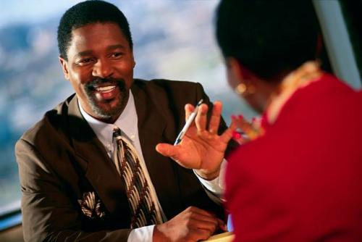
What is an Interview
The interview is where employment information is exchanged--you learn about the job you are seeking and the employer learns about your job-related qualifications.
You are able to sell your skills to the employer to convince them you are the best candidate.

Slide 6
Objective #2
Parts of the Interview

Slide 7
What makes up the Interview
1) Preliminary Screening with Human Resources:
-Focus is on employment history, reviewing application and resume for accuracy, and determining if applicant is minimally qualified
2) Hiring Interview with the “Hiring Manager:”
-Focus is on the specific skill sets and what your can bring to the position.

Slide 8
Objective #3
Types of Interviews

Slide 9
Individual Interview
Conducted by one interviewer. You meet with them one-on-one

Slide 10
Panel Interview
Conducted by more than one interviewer. Can consist of up to 4 or more interviewers.

Slide 11
Objective #4
What to do before Interview

Slide 12
Be Prepared
Not Panicked

Slide 13
Before the Interview
Examine your career goals
Know yourself and your skills well
Memorize your resume
Research the company
Practice interviewing

Slide 14
Dress for Success- Women
Suit, dress, or professional looking pants suit
Always be clean, neat, freshly pressed
Select conservative but flattering styles
Choose practical footwear (high heels).

Slide 15
Dress for Success- Men
Suit and tie, or dress pants and sports coat
Always be clean, neat, freshly pressed
Select conservative but flattering styles
Be careful of bold/bright colors

Slide 16
What to do on Interview day
BE ON TIME! (Arrive 30 min. early)
Greet the receptionist warmly
No gum or smoking
Cellphones off and leave earphones home

Slide 17
Objective #5
What to do during the interview

Slide 18
Use these techniques
Be Aware of your body language
Be diplomatic and truthful
Make positive comments about former employers
Bring extra copies of references and resumes
Use a portfolio/briefcase to carry your items

Slide 19
Begin with the Big 3!
Firm Handshake
Genuine Smile
Direct Eye Contact

Slide 20
The Employer may begin with
“Small Talk” to put you at ease
Provide company and job info so you understand what the job entails
Evaluate your social skills; conversation and grammar skills; composure, attitude enthusiasm, and interests

Slide 21
The Applicant Should
Listen and respond with concise complete sentences
Stay on track and don’t ramble
Conduct Dialogue, not monologue

Slide 22
The Applicant Should
State contributions you can make instead of the security the company offers
Answer questions focusing on job-related skills and abilities
Sell Yourself!

Slide 23
Questions during Interview
Answer questions about your work experience, educational history, and job-related qualifications

Slide 24
Sample questions asked
Tell me about yourself
Why are you interested in joining our company
What qualifications for you have for the position
Why are you leaving your current job

Slide 25
Sample questions asked
What are your strengths and weaknesses
Where do you see yourself in 5 years
Can you give an example of a decision you had to make under pressure and how you approached it

Slide 26
Should I ask any questions
YES!!!!!!
Shows your interest in the company and position
Demonstrates that you have done your research
Allows you to see if the company and positon are a right fit for you

Slide 27
What should you ask
How will I be trained
What are the department’s goals for next year
How does this position help to meet those goals
What are the opportunities for advancement

Slide 28
What should you ask
How are performance reviews conducted
What is the next step in the interview process

Slide 29
How to Handle your Salary
Allow employer to approach the subject first
Know about salaries for the potion in your geographical area
Be realistic about your expectations

Slide 30
How to Handle your Salary
Be tactful in how your present your salary request
Give a salary range rather than an exact amount if asked to state a specific salary

Slide 31
Objective #6
Closing the Interview

Slide 32
Final Steps of the Interview
Clarify the next step in the process
Remember to offer your references
Prepare a closing statement to show interest

Slide 33
Final Steps of the Interview
Thank the Interviewer
End with the Big 3
Firm Handshake, Genuine Smile, Eye Contact
Thank the staff on the way out

Slide 34
Objective #7
After the Interview

Slide 35
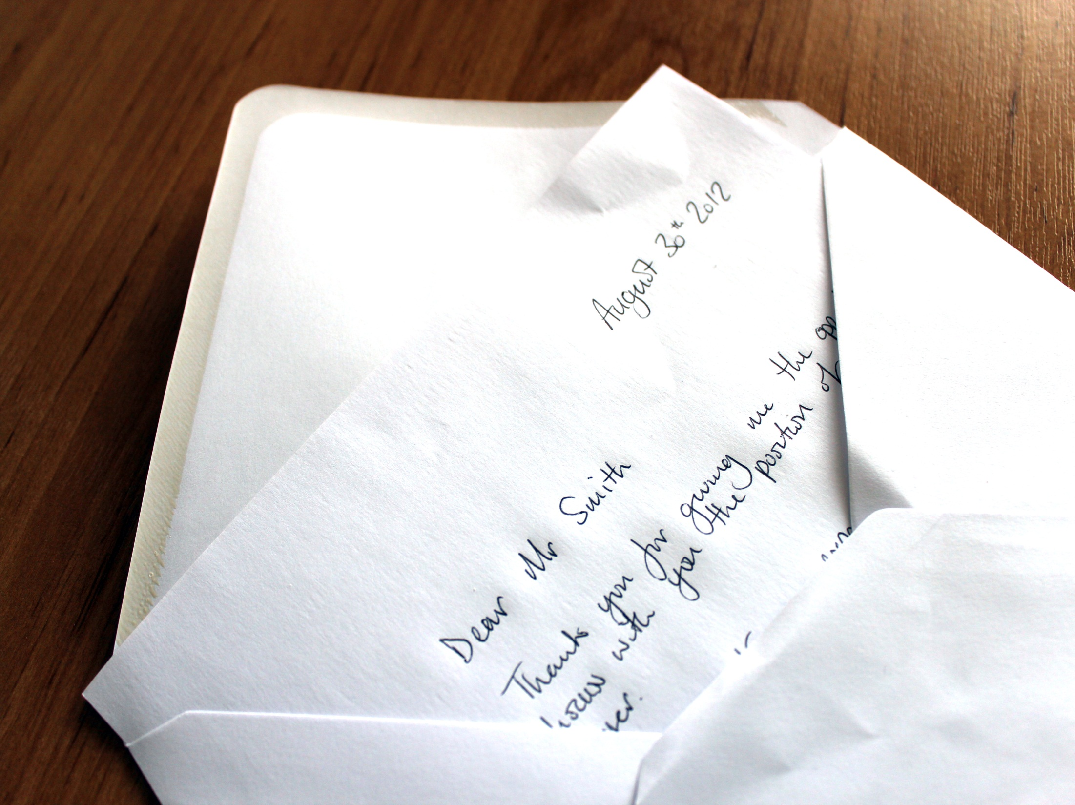
Effective Follow-Up
Immediately send a thank you letter
Follow up with additional info if requested
Review your performance

Slide 36
Effective Follow-Up
Learn from the experience, stay positive, and continue to actively search for jobs
Evaluate the position carefully before accepting

Slide 37
Use these tools
Is now in the palm of your hand

